Slide 1
Final Year Project Design
DAIFAT MUSSA OTHMAN BITAM/9/21/026/TZ
AGRICULTURE MANAGEMENT SYSTEM
DR. HUSSEIN SHAABAN

Slide 2
Introduction
An agriculture management system aims to provide farmers with valuable data and analysis to enhance decision-making in crop management.
The existing systems focus on explaining the importance of crops and their safety, they lack detailed budget template for crop cultivation, making it challenging for farmers to input and track their expenses.
Hence, I decided to develop a system which enable farmers to input post harvest data, expenses, and it will provide local store details where the farmers can go and get the best seeds and so on.
There will be registered contributors who are experts in agriculture who will be able to add information based on agriculture like when to start farming and when to harvest in order to get profit.

Slide 3
Feasibility Study Report Summary
Technically, the project can be performed as there is availability of hardware and software needed, and the one to implement the system is also available with required skills.
Economically, the system doesn’t need huge amount of money, and it will help to reduce the loss which most of the farmers face due to lack of tracking expenses tools and due to farming in wrong seasons because of lack of information.
Legally, the system doesn’t have any conflict with legal issues and it is legally acceptable by laws

Slide 4
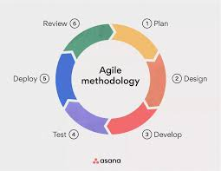
Methodology
Agile Methodology
Agile breaks down larger projects into small, manageable chunks called iterations. The highest priority is to satisfy customer and it easily adapt to changes.

Slide 5
Functional requirements
Farmers should be able to create accounts, log in securely, and manage their profiles.
User roles should be defined, such as regular farmers, administrators, and contributors.
farmers should be able to input expenses related to crop cultivation.
Farmers should be able to input data post-harvest such as sales and profits.
It should include directory of local stores.
Farmers should be able to give comment related to local store.
It should include information on crop varieties, cultivation techniques, pest management, and safety measures

Slide 6
Non-functional requirement
Fault Tolerance: Implement mechanisms to handle system failures gracefully, ensuring minimal disruption to users.
Response Time: The system should provide quick responses to user interactions, with minimal latency.
Scalability: The system should be scalable to handle an increasing number of users and data over time.
Throughput: Ensure that the system can efficiently process a large number of simultaneous transactions.
Access Controls: Define and enforce access controls to ensure that users can only access data and functionalities relevant to their roles.

Slide 7
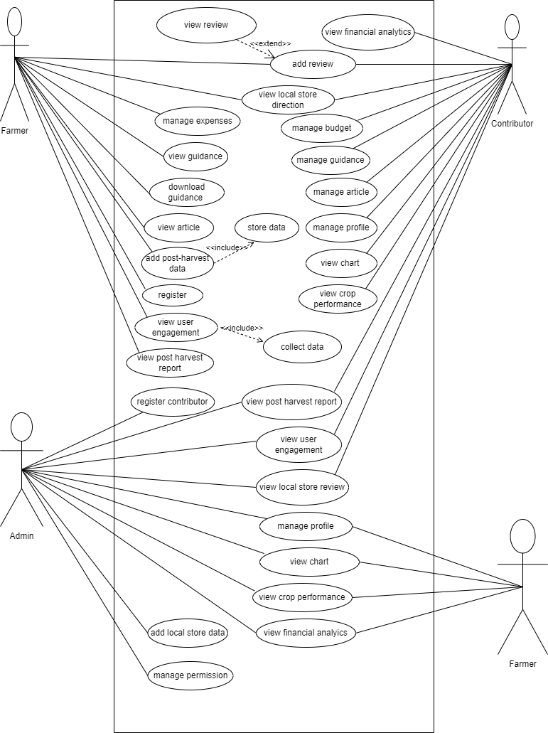
Requirement Modeling USE CASE DIAGRAM

Slide 8
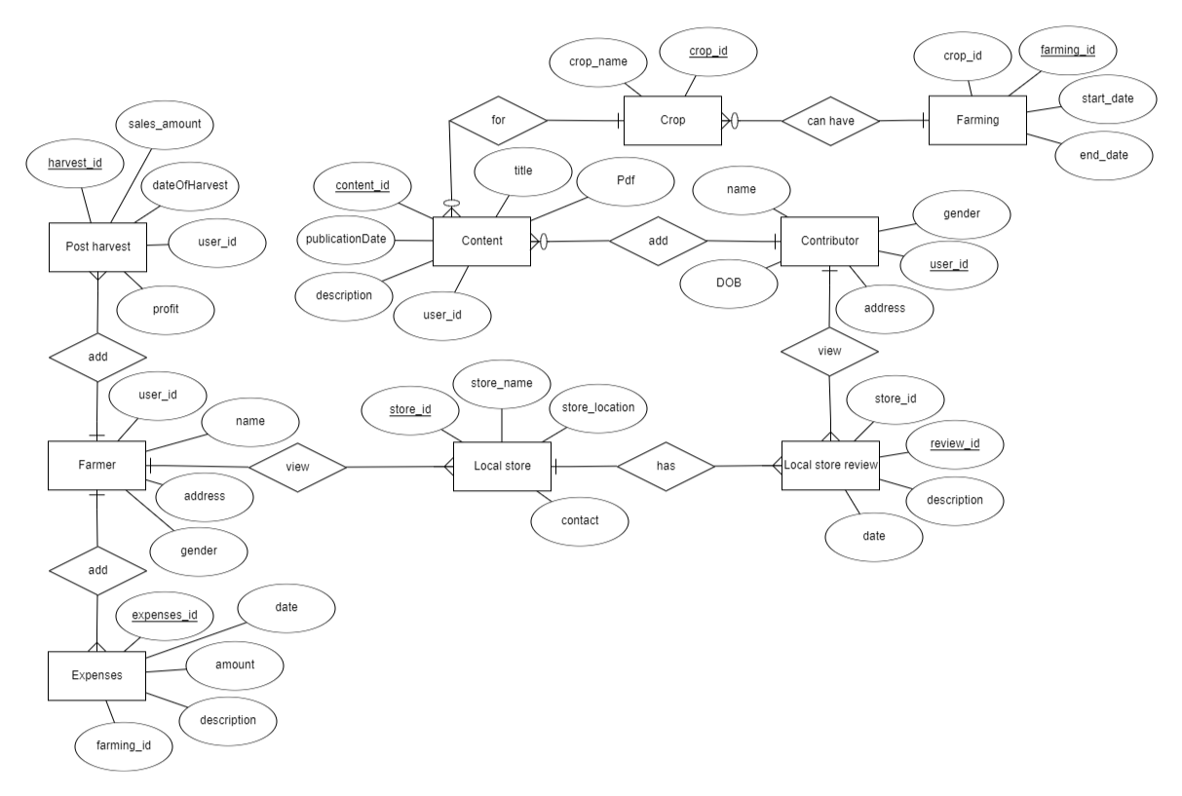
ERD

Slide 9
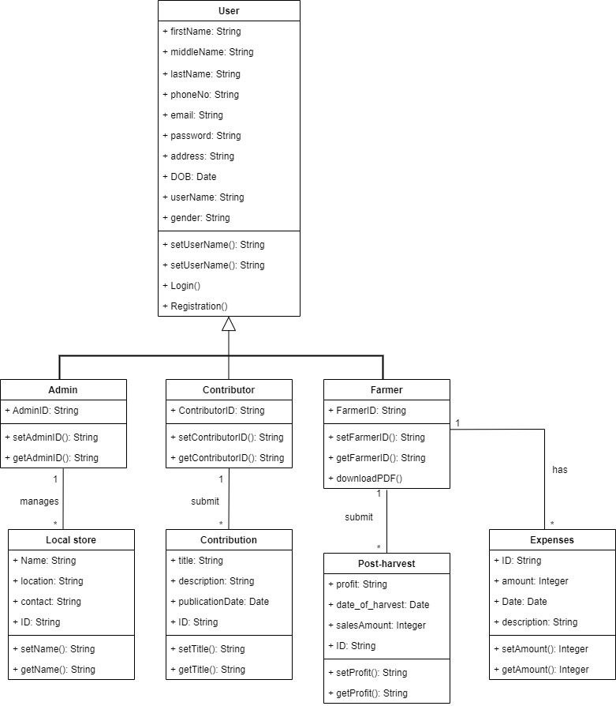
CLASS DIAGRAM

Slide 10
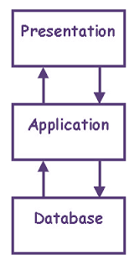
System architecture (Process Flow)

Slide 11
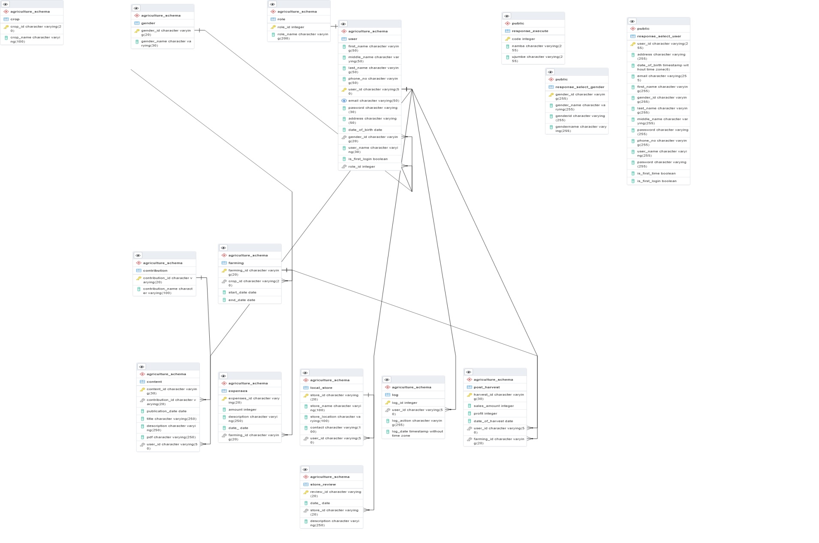
Database relational model

Slide 12
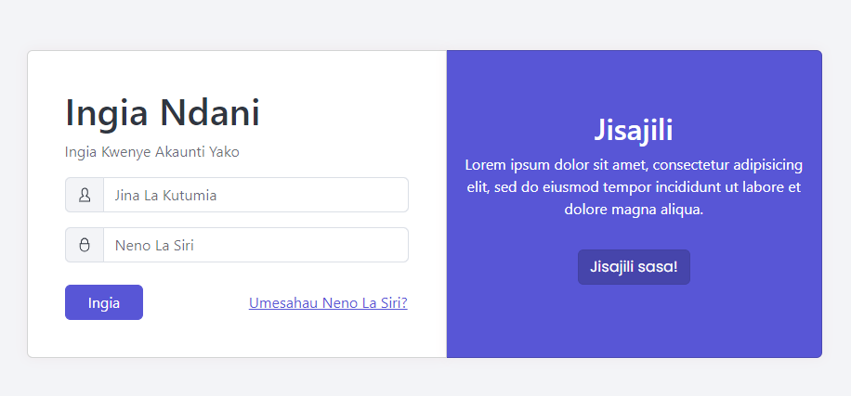
Design Demonstration Login form

Slide 13
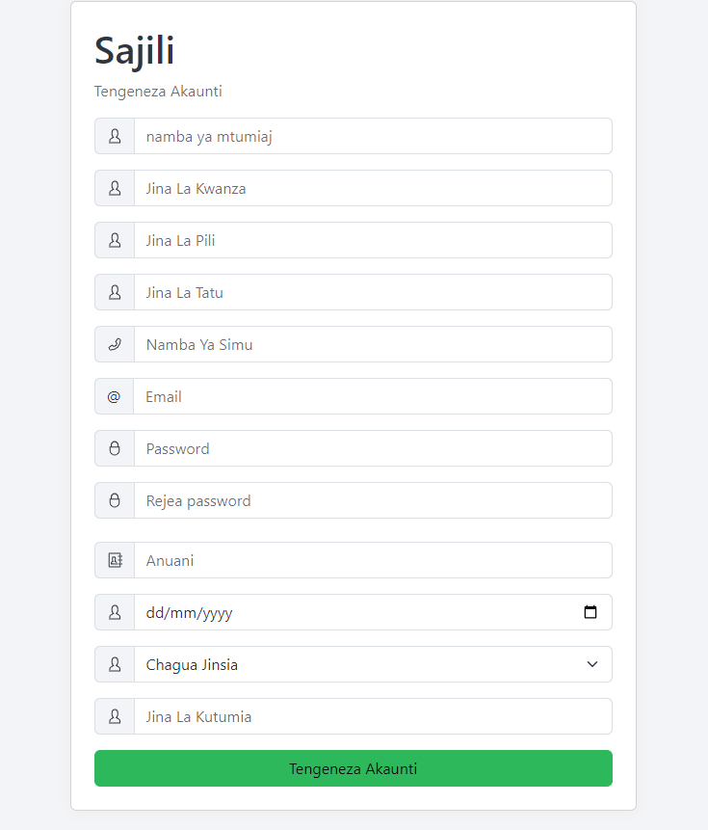
Registration form

Slide 14
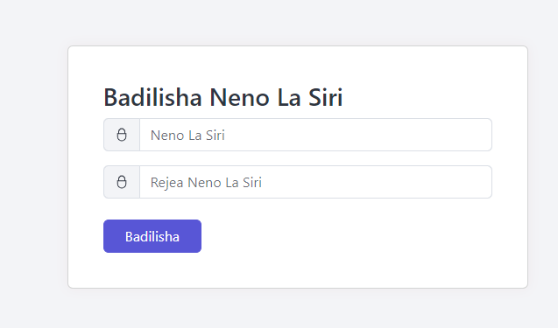
Change first password

Slide 15
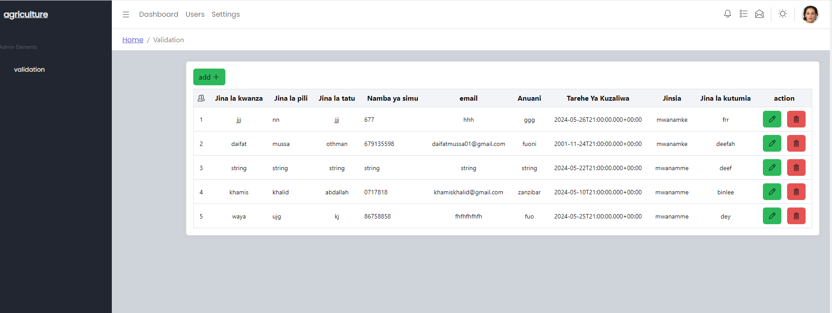
Users details

Slide 16
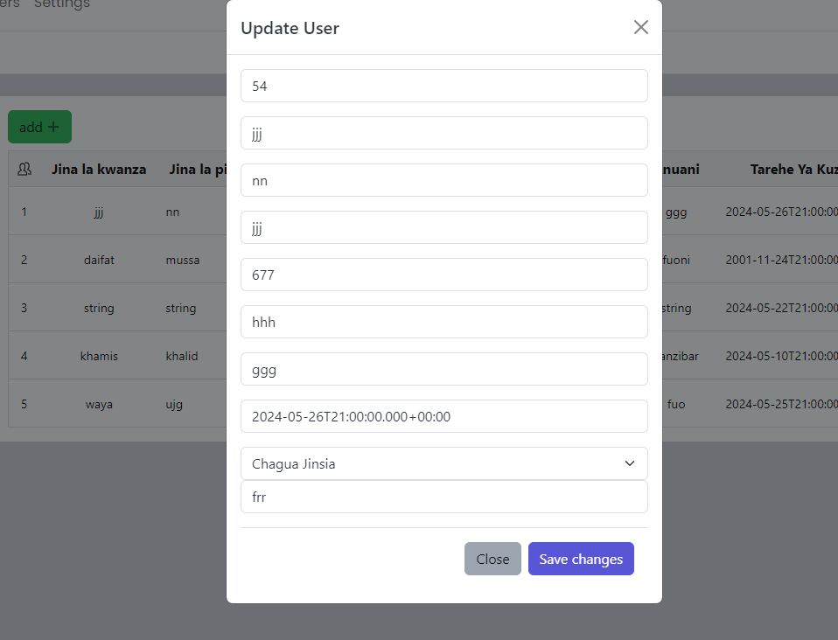
Update users

Slide 17
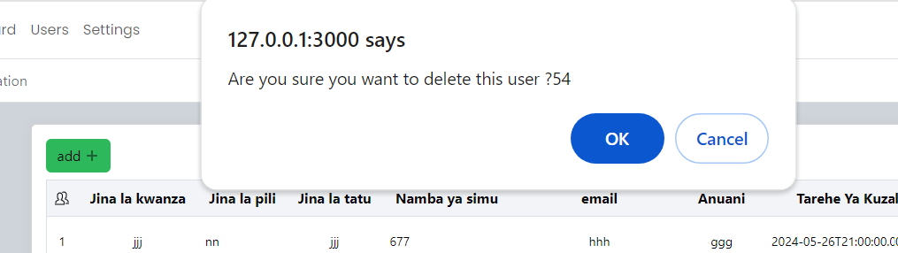
Delete users

